Slide 1

Adaptor Design Pattern

Slide 2
What type of design pattern is an Adaptor
An adaptor is a structural design pattern.
Structural design patterns are used when you need to change the functionality of an existing class

Slide 3
What is an Adaptor?
An adaptor provides an interface to change one data type to another data type.
Typically you use the Adaptor between two classes to change the data type.
The adaptor can inherit both classes in order to change the data type more easily.

Slide 4
What Is needed to use an Adaptor?
An adaptor can be used anywhere that you know what the translation between two data types is.
For instance you want to create a line but you have the points data type.
You can use the Adaptor to create an interface to translate these two points into a line and return the line data type
That way if you have a shape class that only takes in lines but you are given the data type points you can use your adaptor to translate these points into the lines that you need for your shape class

Slide 5
Why is this useful
I have personally had to change data types a lot of times in this class while doing projects.
For instance when I read a text file in as data and all the data comes in as strings.
Usually I solve this problem by coding in line a translation to the data type as needed.
However this solution requires me to recode the same solution over and over for each time I need to translate.
Another possible solution is creating a method that solves this problem, However if I create a method and another class needs this solution I’m am then violating the single responsibility principal of SOLID programming since the shape class does not need to know how to convert points into lines any more then it needs to know how to convert strings into ints everything inside the shape class should relate to the Shape datatype

Slide 6
Why is it useful continued
The better solution would be having a independent class (adaptor) that has a single responsibility of translating strings to ints, lines to points, characters to askii.
Any kind of video game programming uses adaptors all the time
You pick up your sword => the sword object becomes an inventory object.
You put your inventory sword into storage => the inventory object becomes a storage object.
I take the sword out of storage and equip it => it becomes an equipment object

Slide 7
How I used it
I wrote a program to read data from an in memory database.
This data had the population of all the people in the united states however this data came in as a string it also had data in millions instead of data in ones
I used the singleton to create the database since I only wanted one database ever.
I used the adaptor to change the strings from the data type it came in as to ints or strings as I needed it.
I used the State pattern to change the state from accepting immigrants to not accepting immigrants

Slide 8
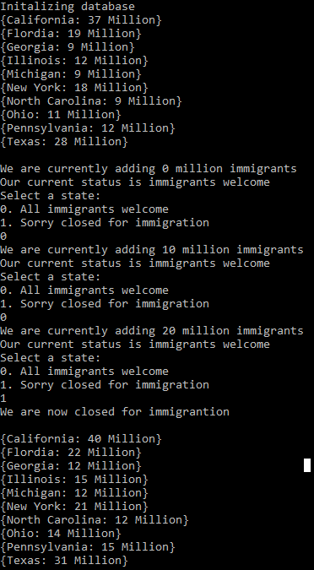
Example:

Slide 9
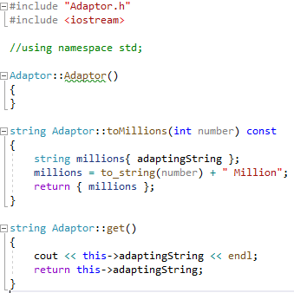
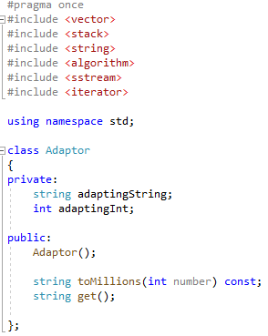
Adaptor Code

Slide 10
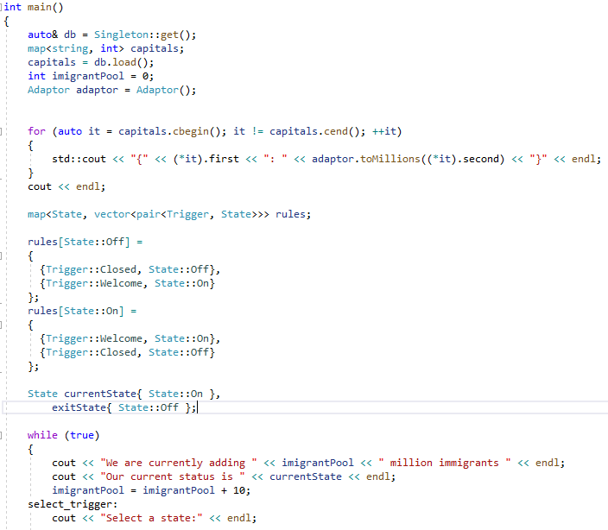
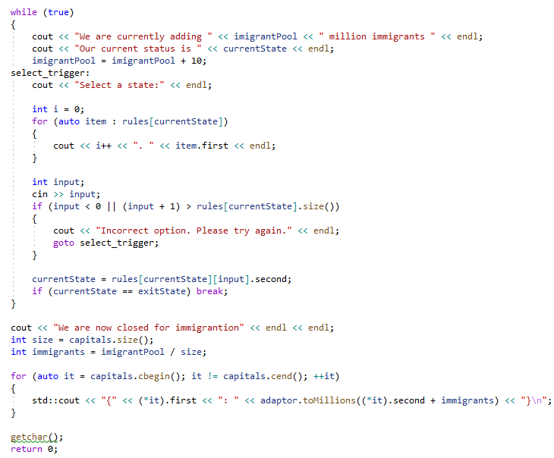
Main Code

